Slide 1
CAKE

Slide 2
Cake is a form of sweet dessert that is typically baked. In its oldest forms, cakes were modifications of breads, but cakes now cover a wide range of preparations that can be simple or elaborate, and that share features with other desserts such as pastries,, custards, and pies.

Slide 3
Baking Ingredients & Function: A Breakdown
Do you know the difference between baking powder and baking soda? Or what an egg white can do that an egg yolk can’t in your recipes? It’s good to know what the ingredients you’re using in your everyday life do to make your baked goods sweet and delicious!
Baking Powder Made from Cream of tartar(Cream of Tartar is an acid salt used often in cooking, and is an ingredient in most baking powders) and starch, baking powder is a leavening agent, which causes your batter to rise. It has a built-in acidic ingredient, so you don’t need to add anything else (unlike with baking soda). Too much baking powder results in a bitter tasting product, while too little results in a tough cake with little volume.

Slide 4
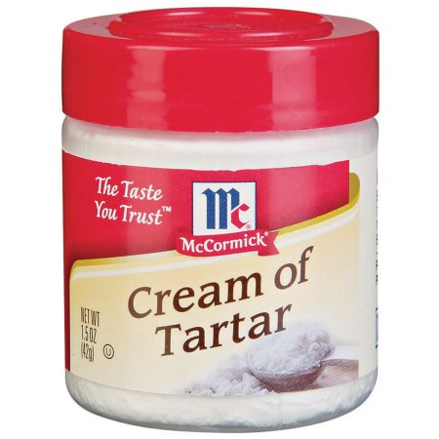

Slide 5
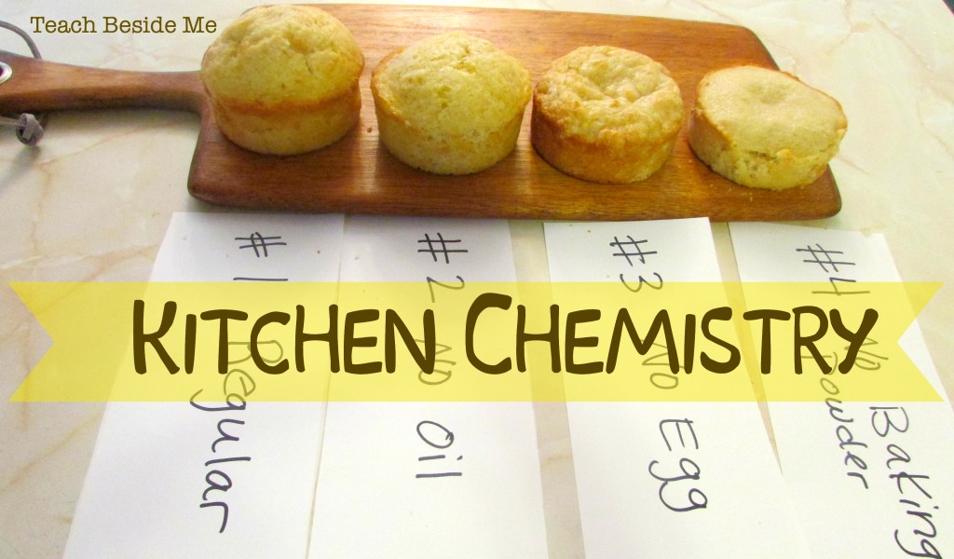

Slide 6
Baking Soda Baking soda is pure sodium bicarbonate, and needs to be paired with an acidic ingredient like honey, chocolate, or yogurt. Like baking powder, it’s a leavening agent. Use too much, and you’ll have a soapy, coarse cake. Baking soda is four times as strong as baking powder.

Slide 7
Butter As a solid fat, butter is better suited for baking than any other fat product. Butter in particular adds flavour, with a melting point just below body temperature, which is why some cookies and baked goods tend to “melt in your mouth.” It also helps in leavening and adds moisture.

Slide 8
Eggs Eggs do a lot in baking, but most importantly they’re a leavening agent (adding volume), and are a binder, meaning they keep the finished product together. You can use the whole egg, for flavour, binding, thickening, or glazing, or you can use egg whites and egg yolks for separate things. Egg whites are a drying agent, and add moisture and stability. Egg yolks contribute to texture and flavour.

Slide 9
Flour Flour holds ingredients together in baking. When flour protein is combined with moisture and heat, it develops into gluten. Different types of flours have different levels of protein, which are suitable for various baked goods.

Slide 10
Milk The protein in milk softens, contributes moisture, and adds colour and flavour to baked goods. It’s a double-whammy in terms of function, as it gives the dough or batter strength and structure, as well as adds tenderness, flavour and moisture.
Salt Salt does a couple different things in baking. For one, it helps preserve the colour and flavour of flour. In bread, it controls of the fermentation rate of yeast, and strengthens the gluten protein in dough. Though it seems salt is out of place in sweet recipes, if you skip it, your product will taste very bland, as it also enhances flavour.

Slide 11
Shortening Shortening is any fat that is a solid at room temperature. Shortening is just 100%, solid fat made from vegetable oils, almost exclusively used in baking. When you use shortening instead of butter in baking, you’ll get a softer and more tender, though taller and less flavourful, product. Shortening is a type of fat normally used for baking or cooking. It is made from different types of oils and has low water content.

Slide 12
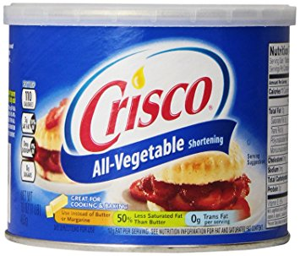

Slide 13
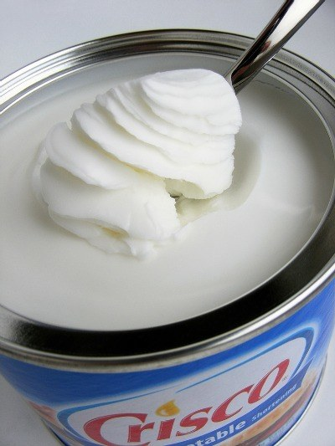

Slide 15
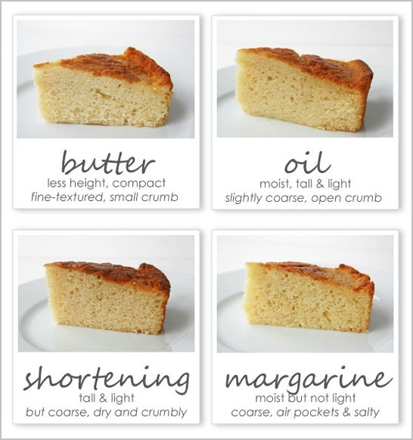

Slide 16
Sugar In any given recipe, sugar is performing a number of functions you’re probably not aware of. For one, it adds texture, like keeping your baked foods soft and moist. Sugar sweetens by the sugar caramelizing in the recipe, and adds that “crunch” to the crusts of cakes and cookies.

