Slide 1
South Indian Cuisine

Slide 2
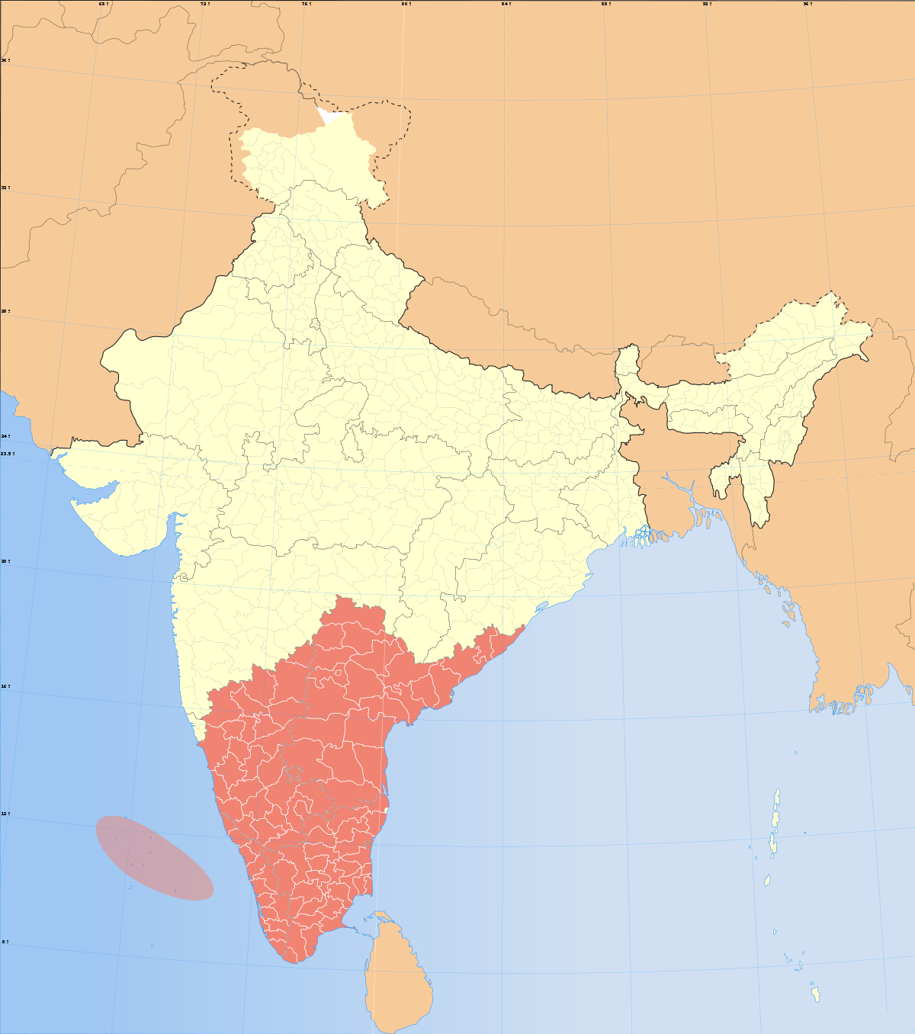

Slide 3
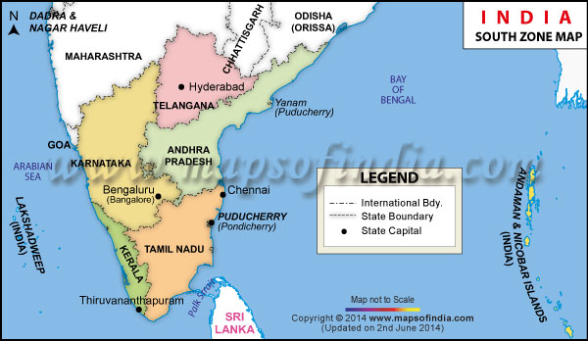

Slide 4
Introduction
South Indian cuisine includes the cuisines of the five southern states of India: Andhra Pradesh, Karnataka, Kerala, Tamil Nadu and Telangana.

Slide 5
The cuisine of South India is known for its light, low calorie appetizing dishes. The traditional food of South India is mainly rice based. The cuisine is famous for its wonderful mixing of rice and lentils to prepare yummy lip smacking dosas, vadas, idlis and uttapams. South Indian dishes are not just delicious, but also very easily digestible. The best part is that South Indians do not use much of oil for cooking their meals.

Slide 6
Geographical and cultural influence on the region’s cuisine:
South India has hot, humid climate and all its states are coastal. Rainfall is abundant and so is the supply of fresh fruit, vegetables, and rice.

Slide 7
Style of food
By and large, South Indian cuisine is perhaps the hottest of all Indian food. Meals are centered around rice or rice-based dishes. Rice is combined with Sambaar (a soup-like lentil dish tempered with whole spices and chilies) and rasam (a hot-sour soup like lentil dish), dry and curried vegetables and meat dishes and a host of coconut-based chutneys and poppadums (deep-fried crispy lentil pancakes). South Indians are great lovers of filter coffee.

Slide 8
Staple foods
No South Indian meal is complete without rice in some form or other – either boiled rice or Idlis (steamed cakes made from rice batter), Dosas or Uttapams (pancakes made from a batter of rice and lentil flour).
Daals (lentils) are also a part of most meals

Slide 9
Cooking oils commonly used
Coconut oil is most commonly used for cooking and frying. Vegetable oils like sunflower and canola are also used and ghee is poured over rice during daily meals or in special occasion dishes.

Slide 10
Important spices and ingredients
Curry leaves, mustard, Asafetida, pepper and peppercorns, tamarind, chilies and fenugreek seeds.

Slide 11
Popular dishes
Idlis, Dosas, Vadas, ​Sambaar, Uttapams, Rasam, Payasam....

Slide 12
Andhra Food
Andhra food is the spiciest and the hottest of all the South Indian cuisines. There is a liberal use of oil, tamarind and chilli powder (Guntur). An interesting thing is that though Hyderabad is the capital city of Andhra Pradesh, its cuisine is absolutely distinct from that of Andhra cuisine.
Popular Vegetarian Food: Pesarattu, gongura, pulihora, avakkai (cut raw mango) pickle Popular Non-vegetarian Food: Kodi iguru(fry), Kodi pulusu(gravy), Chepa pulusu etc

Slide 13
Karnataka Food
In Karnataka, lunch is mostly served on a plantain leaf(Banana). There is a higher percentage of vegetarians in Karnataka; therefore, their cuisine mainly consists of vegetarian dishes. The food of Karnataka is the mildest of all. Here, the use of chilli powder is done sparingly(small amount). They make a liberal use of palm sugar(derived from variety of palm trees) or brown sugar(brown color because of molasses). Udupi(name of place in karnataka) food forms part of the cuisine of Karnataka.
Popular dishes: Ragi rotti, Akki rotti, Khara Bisi bele bath, Kesari Bath, Vangi Bath, Saaru, Bath, Davanagere Benne Dosa, Ragi mudde, and Uppittu. In South Karnataka, Rava Idli, Mysore Masala Dosa and Medhu Vada are extremely popular. Among the sweet dishes, Karnataka is well known for its wonderful preparation of Mysore Pak, Dharwad pedha, Pheni, Chiroti.

Slide 14
Kerala Food
Kerala cuisine mainly consists of coconut based foodstuff. Since, Kerala is the chief exporter of coconut; therefore coconut is used liberally over here. Kerala is a place well known for its beautiful backwaters(different lakes or chain of lakes) and thus, this place is a paradise for seafood lovers. There is an abundance of seafood specialties.
Popular Vegetarian Food: Aviyal, olan, Popular Non-vegetarian Food: Shrimp coconut curry, fish poriyal

Slide 15
Tamil Food
The cuisine of Tamilnadu consists of plenty of mouthwatering vegetarian and non vegetarian dishes. Tamilnadu has a lot to offer, when it comes to food.
Popular Vegetarian Food: Idli, sambar, rasam, vada, thayir sadam (yogurt rice), thayir vadai, murukku, kootu, poriyal, uthappam, appalam and papadum and thayir pachadi Popular Non-vegetarian Food:, Chettinad pepper chicken and karuvadu kozhumu (dried preserved fish flavored curry)

