Slide 1
Natural Disasters - Impact on Development

Slide 2
During the past four decades, natural hazards such as earthquakes, droughts, floods,
storms and tropical cyclones, wildland fires, and volcanic eruptions have caused major loss
of human lives and livelihoods, the destruction of economic and social infrastructure, as
well as environmental damages. Economic losses have increased almost ten times2
this period. In recent years, floods in Bangladesh, Ethiopia, Guinea, India, Mozambique,
Nigeria, Sudan, Thailand, Venezuela, Vietnam and Algeria, volcanic eruptions in
Indonesia, Montserrat, Ecuador and the Philippines, and earthquakes in Japan, Turkey, El
Salvador, Indonesia, India and Peru have created widespread social, economic and
environmental destruction.

Slide 3
Major natural disasters can and do have severe negative short-run economic impacts.
Disasters also appear to have adverse longer-term consequences for economic growth, development and poverty reduction.
Natural disasters cause significant budgetary pressures
Governments need appropriate risk management strategies for future disasters that include medium-term financial planning for 8 – 10 years

Slide 4
Natural disasters are a increasingly phenomena that we all clearly perceive and know that may have a direct impact on the welfare of a regions where it hits and also on specific households indicators in such areas.
Depending of where we live, hurricanes, earthquakes, floods, droughts, etc, are threats to lives, properties, productive assets, and also can have an impact on social indicators.
the impact of such events could result in an immediate increase in poverty

Slide 5
The impact of a natural disaster may also cause inequalities. The poor, who suffer from income fluctuations, and also have limited access to financial services, in the aftermath of a disaster may be more prone to reduce consumption and have a decreasing shock in other household indicators as a consequence.
In addition, there are a number of non poor, or close to be, who are not insured against from those risks, and then may fall into poverty as consequence of decapitalizing when coping with the shock, depending the impact and likelihood of falling into poverty of the initial stock assets and coping mechanisms.

Slide 6
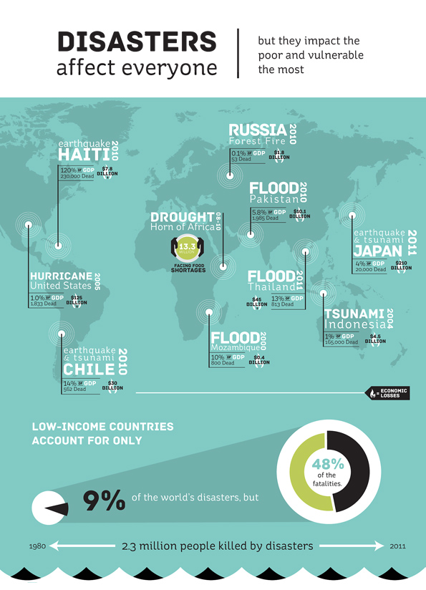

Slide 7
