Slide 1
Managing Disasters
Disasters can be managed effectively through close coordination with various government and non-
government agencies. ...... Do you know the agencies that work for our safety?
Let’s understand the various agencies which play a key role in Disaster Management.

Slide 2
How are Disasters Managed?
The flow chart given below would give you a better understanding about the management of disasters at various levels in our country.
India with its federal system of Government has specific roles for the Central and the State Governments.
The country has an integrated administrative machinery for management of disasters at the National, State, District and Sub- District levels. The basic responsibility of undertaking rescue, relief and rehabilitation measures in the event of natural disasters is with the concerned State Governments.
The Central Government supplements the efforts of the State Government by providing financial and logistic support.

Slide 3
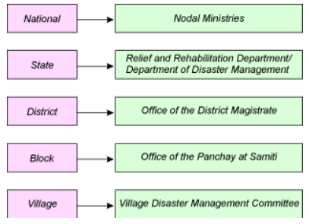

Slide 4
NATIONAL LEVEL:
The response from the Central Government is based keeping in view the following factors:
1. The gravity of the disaster
2. The scale of the relief operations
3. The requirements of the Central assistance for augmenting financial resources and logistics support
at the disposal of the State Government.
The Ministry of Home Affairs is the Nodal Ministry at the centre for coordinating disaster management activities for all natural hazards except drought which is taken care by Ministry of Agriculture under the Department of Agriculture and Cooperation.
Other Ministries are assigned the responsibility of providing emergency support in case of disasters that fall within their preview.

Slide 5
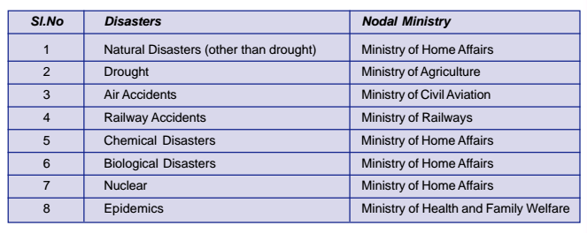

Slide 6
STATE:
The responsibility to cope up with natural disasters is essentially that of the State Government. The role of the Central Government is to support in terms of physical and financial resources. The Chief Minister or the Chief Secretary of the State heads a state level committee which is in overall charge of the relief operations at the State and the Relief Commissioner who is in charge of the relief and rehabilitation measures in the wake of natural disasters.
In many of the states, Secretary, Department of Revenue is also in charge of relief operations. The states have the relief manual called as the ‘State Relief Code’ and the State Contingency Plan which guides them to manage disaster scenarios.

Slide 7
DISTRICT:
The district administration is the focal point for implementation of all governmental plans and activities.
The actual day-to-day function of administering relief is the responsibility of the District Magistrate/ District Collector/ Deputy Commissioner who exercises coordinating and supervising powers over all the departments at the district level.
The 73rd and the 74th constitutional amendments recognise Panchayati Raj Institutions as ‘Institutions of self- government’. These local bodies can be effective instruments in tackling disasters through early warning system, relief distribution, providing shelter to the victims, medical assistance etc.
A Disaster Management Committee has been set up at the district level headed by the District Magistrate and officials from the health department, Irrigation Department, Veterinary Department, Department of Water and Sanitation, Police, Fire Services, representatives from National and International NGOs, etc.
The Disaster Management Committee which is basically the decision making body takes the help of the Disaster Management Teams, like the Fire Services, Police, Health practioners etc.

Slide 8
BLOCK:
The Block Development Officer/ Taluka Development Officer is the nodal officer at the Block level for all the disaster management activities. The Disaster Management Committee at the Block/ Taluka level is headed by this Nodal Officer. The other members of the committee are officers from the Social Welfare department, Health department, Rural water supply and Sanitation Department, Police, Fire Services, representatives from youth organizations, Community Based Organizations, Non Governmental Organizations, eminent senior citizens, elected representatives etc. The main functions of Block Disaster Management Committee are:
● Helping the Block administration in preparation of the Block Disaster Management Plan
● Coordinating training for the members of the Disaster Management Teams
● Carry out mock drills

Slide 9
VILLAGE:
At the village level, the Village Disaster Management Committee headed by the Sarpanch/ Village Headman is responsible for preparing the Village Disaster Management Plans and also coordinating with various agencies for providing training to the Disaster Management Teams. The members should see to it that mock drills are carried out by the villagers at regular intervals by the villagers for various hazards.
It is accepted that the Government alone cannot take on the entire responsibility of Disaster Management. Apart from national, state, district and local levels there are various institutions who are involved in disaster management at various levels in the country. This includes the police and Para-military forces, Civil Defence and Home Guards, fire services, National Cadet Corps (NCC), Youth Organizations, UN agencies, International and National voluntary groups, public and private sector enterprises, media etc. play a major some of the organizations have been mentioned below.

Slide 10
UN DISASTER MANAGEMENT TEAM (UNDMT) – INDIA
UN Office for Coordination of Humanitarian Affairs (UN OCHA), has been made responsible by the UN General Assembly mandate for all International disaster response. In India, UNDMT represents various UN agencies to implement disaster preparedness and mitigation efforts and strengthen Government’s capacities on disaster risk management. The UNDMT has representation from various UN Agencies such as FAO, ILO, UNDP, UNFPA, UNICEF, WFP and WHO which act together whenever there is a disaster. The primary purpose of the UNDMT is to ensure prompt, effective and concerted country level disaster preparedness by the UN system, and the response when appropriate.

Slide 11
INDIAN ARMED FORCES:
The Armed Forces are the core of the government’s response capacity. They intervene and take on specific tasks only when the situation is beyond the capacity of civil administration. Due to their ability to organize action in adverse ground circumstances, speed of operational response and the resources and capacities at their disposal, the armed forces have historically played a major role in emergency support functions such as communications, search and rescue operations, health and medical facilities, transportation, power, food and civil supplies, public works and engineering, especially in the immediate aftermath of disaster.

Slide 12
NATIONAL CADET CORPS (NCC)
The National Cadet Corps, a body formed in 1948 aims at:
● developing qualities of character, courage, comradeship, discipline, leadership, secular out look, spirit of adventure and sportsmanship and the ideals of selfless service among the youth to make them useful citizens.
● This it does by creating a human resource of organized, trained and activated youth.
● Providing leadership in all walks of life including the Armed Forces and making themselves available for the service of the nation.

Slide 13
CIVIL DEFENCE
Civil Defence volunteers being trained .Civil Defence aims at saving life, minimizing damage to the property and maintaining continuity of industrial production in the event of a hostile attack. The two war emergencies faced by the country in 1962 and 1965 compelled the Government of India to reorient its emergency training activities from natural disasters to those concerning protection of life and property against enemy action.
The National Civil Defence College was founded on 29th April 1957 at Nagpur as the Central Emergency Relief Training Institute (CERTI) to function as the training wing of the Emergency Relief Organization of the Government of India.
This Central Institute focuses on advanced and specialist training to the leaders of relief services, which was essential for efficient conduct of relief operations during natural disasters. Today there are around 500,000 Civil Defence Volunteers throughout the country.

Slide 14
NATIONAL SERVICE SCHEME (NSS)
Ever since independence there has been growing awareness of the desirability of involving students in national services. The first Education Commission (1950) recommended the introduction of national service by students on a voluntary basis.
Ministry of Education introduced the National Service Scheme during 1969-70. The motto of NSS is “NOT ME BUT YOU”. It underlines that the welfare of an individual is ultimately dependent on the welfare of the society as a whole. The NSS symbol is based on the “Rath Wheel” of the Konark Sun Temple of Orissa. It stand for dynamism and progressive outlook of youth. Any student enrolled as a NSS volunteer, as per NSS Manual should put in atleast 240 hours of useful social work in a continuous period of two years (i.e. 120 hours per year). A work diary is to be maintained by each NSS volunteer, which will help him/her in the assessment in his/her performance. Such volunteer is eligible to get NSS Service Certificate from the colleges. The Service Certificate given in the NSS Manual should be strictly adhered. Each NSS unit in the college is expected to adopt a near by village/slum and work for its all-round development. Regular activities and special campus should preferably be organized in the adopted village/rural unit/slum for this purpose.

Slide 15
In the tsunami affected areas of Tamil Nadu about 1200 NSS volunteers have spread themselves into affected areas with relief material especially in the slums. In Pondichery also, the NSS volunteers have been deployed for relief work and they are constantly working under the supervision of NSS Regional Director.

Slide 16
NEHRU YUVA KENDRAS:
The Nehru Yuva Kendras were launched in the year 1972 as part of the Silver Jubilee celebration of India’s Independence. This was on the recommendation of the National Advisory Board on Youth with the objective of providing the non-student rural Youth avenues to take part in nation building activities and also to provide opportunity for the development of their own personality and skills. As volunteers the members have helped the community at times of crisis. Today, it functions under the Ministry of Youth Affairs & Sports. NYKS is a registered society and is governed by a Board of Governors headed by the Minister of Youth Affairs & Sports.

Slide 17
HOME GUARD
Home Guard is a voluntary force, first raised in India in December 1946, to assist the police in controlling civil disturbance and communal riots. Subsequently, the concept of a voluntary citizen’s force was adopted by several States. In the wake of Chinese aggression in 1962, the Centre advised the States and Union territories to merge their existing voluntary organization into one uniform voluntary force known as ‘Home Guards.’ The function of Home Guards is to Serve as an auxiliary to the police in maintenance of internal security Help the community in any kind of emergency such as air raid, fire, cyclone, earthquake, epidemic etc. Help in maintenance of essential services Promote communal harmony and assist the administration in protecting weaker sections Participate in socio-economic and welfare activities and perform Civil Defence duties.

