Slide 1
ESTABLISHING ROOM RATES

Slide 2
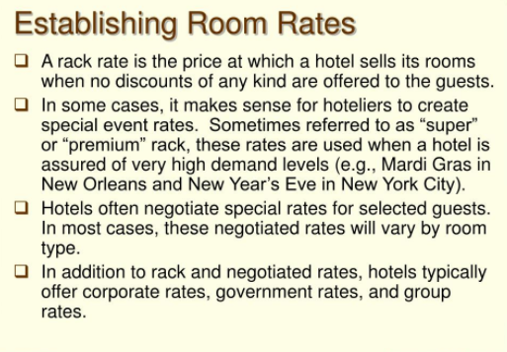

Slide 5
Tariff Fixation
Check-in and Check-out basis
24 hr basis
Night basis
Day rate
According to meal plans

Slide 6
THE MARKET CONDITION APPROACH
Under this very approach, management shall look at comparable hotels in the geographical market, see what they are charging for the same product, and charge only what the market will accept
Some drawbacks of this approach are that it does not take into consideration the value of property, and what a strong sales effort may accomplish

Slide 7
RULE OF THUMB
In this approach, the rate of a room shall be RS1 for each RS1,000 of construction and finishing costs per room, assuming a 70% occupancy rate
To illustrate suppose a 150 room hotel has cost RS9,500,000 of construction and finishing costs
Therefore, the cost per room is RS63,333.33 which would mean that the price per room shall be RS63.33
This approach, however, fails to take into consideration the inflation term(SUPPOSE IF THE OCCUPANCY INCREASES), the contribution of other facilities and services towards the hotel’s desired profitability and assumes a certain level of occupancy rate

Slide 8
HUBBARTS FORMULA
Hoteliers want to maximize their profits and thus collect the highest rate possible for their rooms.
However, the rate cannot be so high that it discourages guests from staying at the hotel, nor can it be so low that it prevents the hotel from making a profit.
This formula is recognized by hoteliers world-wide

Slide 9
The Hubbart formula is used to determine what a hotel’s average daily rate (ADR) should be to reach the hotel owner’s financial goals.
[(Operating expenses + Desired return on investment) – other income]/projected room nights = room rate.

