Slide 1
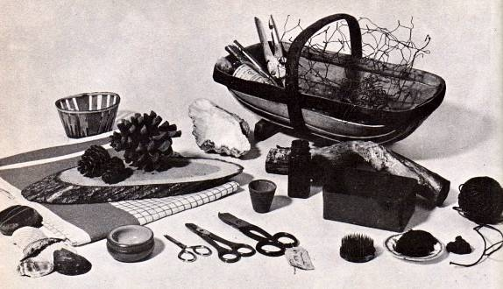
Necessary Equipment for flower arrangement
1- Cutting tools- special type of scissors used for cutting woody stems
Light weight scissors
Knife
2-Equipment for handling material
Buckets
Jugs
Watering can

Slide 2
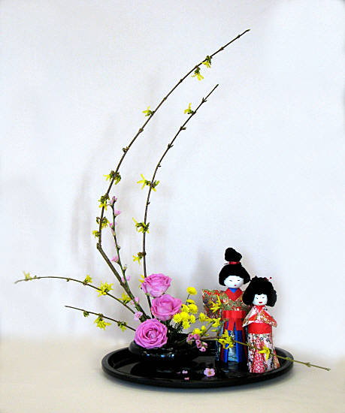
4-Supports for flowers-
Pin holders
Mesh wires
Sand
Oasis
Stub wires

Slide 3
Care and Selection of flowers for flower arrangement
Pluck flowers either in morning or late evening
It is better to select buds or half bloom flowers
Dip plant material in water immediately
Never expose plant material to direct sunlight
Change water on daily basis
Make slanting cuts
Stems should be trimmed
Tallest stem should be 1 ½ times height or width of container
For tall containers 3 ½ times in length of container
Flowers stay longer if aspirin is added
Largest flowers, bright colours and tallest stems should be used in centre or at base

Slide 4
Florist scissors: Ordinary scissors are not suitable for cutting plant steam- they tend to crush the tissues. Choose a pair if florist scissors instead. Mister: A hand-held spray bottle to produce a fine mist of water droplets is an aid to keeping an arrangement looking fresh in warm weather.

Slide 5
Floral tape: The steam binding tape made of plastic and waxed paper is ½ inch wide and is used to over artificial team made of wire.
Knife: Buy a craft knife with a sharp blade scrapping steam, removing leaves, and stripping away thorns.
Wire cutters: These are useful for heavy cutting chicken wire, plastic steam of artificial flowers, and thick stud wires.

Slide 6
Cocktail sticks: Use a cocktail stick or a tooth pick to make holes in florists foam for a soft steam or to attach a fruit to the foam holding a flower display.
Containers: They may or may not be hidden by the plant material. The container must be waterproof if fresh flowers are used. Theme and simplicity in should be kept in mind in choosing the design of the container.
Vase & Jug: A vase is a container that is at least as tall as it is wide and is often quite narrow, with a restricted mouth. It is favorite container for cut flowers.
Basket: This is a popular container for dried flower arrangement. Bamboo baskets are easily available

Slide 7
Bowls & Tray: These are shallow containers
Florists foam objects: This is a plastic container which has internal projections designed to hold a block or round of florist foam.
Bases: An object that is placed underneath the container to protect the surface of the support and or to add to the beauty of the display is called base.
Sponge: Also called oasis. It is synthetically made. It has to be soaked until it become soft. The flowers are inserted in to sponge.

Slide 8
Chicken wire mesh: It is crumbled and used as flower hold accessories like pebbles, rubber, glass pieces, marbles to coca the penholders, serving thread, needles, pins tooth picks supporters.
Pebbles & Marbles: Small pebbles& Marbles have a long been used to hold the steams of cut flowers.

