Slide 1
BENGALI CUISINE

Slide 2
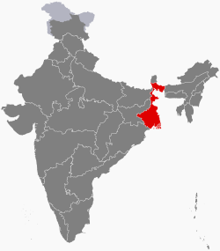

Slide 3
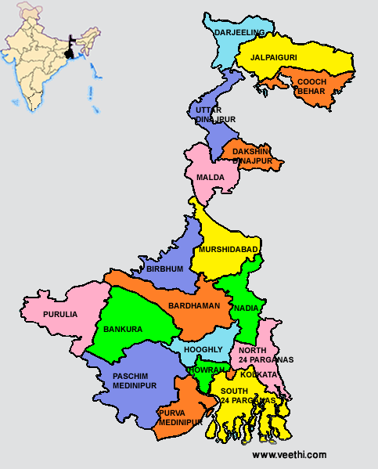

Slide 4
An Introduction
Bengal or, as she is lovingly referred to, "Sonar Bangla“(Golden Bengal), is made up of the Indian state of West Bengal and the country of Bangladesh (formerly East Bengal).
It is one of the most varietal cuisine in India.

Slide 5
The Historical Influences
Bengali food has inherited a large number of influences, both foreign and South Asian, arising from a turbulent(characterized by conflict) history and strong trade links with many parts of the world.
It also saw a fair share of immigrants from various parts of the world - most prominently Jews, Chinese and Afghans who settled down in their own distinct communities in and around Kolkata.

Slide 6
Dravidians then
Aryans then
Muslims then
British

Slide 7
Rise of Kolkata
Kolkata was founded by the British
The city quickly became one of the largest and richest in the world, completely overshadowing Dhaka.
Its offices, ports and bazaars attracted many communities from the rest of India, most notably the Marwari community, millions of whom have made the city their home for three generations. Their influence has been, in particular, in the sweet shops (e.g. Ganguram's)and street foods of Kolkata and West Bengal; many famous sweet shops in the state have Marwari origins.

Slide 8
It is a unique cuisine, local ingredients adapted to French and Italian cooking techniques—characterized by creamy sauces, the restrained use of spices and new techniques such as baking.

Slide 9
Chinese food
The Chinese of Kolkata originally settled into a village called Achipur south of Kolkata in the late 18th century, later moving into the city and finally into its present home in Tangra at the eastern edge of Kolkata, which still houses over 100,000 ethnic Chinese.
With this identity came Chinese food, available at almost every street corner in Kolkata.

Slide 10
As the Chinese opened restaurants for Bengalis, they spiced up the bland Cantonese sauces with sliced chillies and hot sauces, creating unique dishes such as sweet corn soup, fried rice, (noodles), Chickenand dishes.

Slide 11
Bengali Bazaar (A Typical Bengali Market)

Slide 12
Anaj Bazaar (A Vegetable Market)
The variety of fruits and vegetables that Bengal has to offer is incredible. Markets are usually open air ones. This scene is from the busy Sealdah vegetable market in Calcutta. A host of gourds, roots & tubers, leafy greens, succulent stalks, lemons & limes, green and purple eggplants, red onions, plantain, broad beens, okra, banana tree stems and flowers, green jackfruit and red pumpkins are just some of what you'll see if you visit!

Slide 13
Maachher Bazaar (A Fish Market)
Visitors enjoy a tour of Calcutta's fish markets like this one. They are fascinated by the lively koi (climbing perch), the wriggling catfish family of tangra, magur, shingi and the pink-bellied Indian butter fish, the pabda. Among the larger fish, rui (rohu) and bhetki weigh upto eight kilograms. Baskets of pink and silvery ilish (hilsa) match the shine on the glistening blade of the fishmonger's boti. And the fish itself is eaten from top to tail!

Slide 14
Inside The Bengali Kitchen
With the shopping done, the scene shifts to the ranna bari (cookhouse). The storage, cooking and eating areas in a Bengali home were a separate unit and the domain of the womenfolk. This barrack-like cookhouse was a row of rooms running parallel to a wide airy veranda often used as the dining space.

Slide 15
In an orthodox Bengali home, fish and vegetables were cooked over separate fires, rice over another and meat, if cooked at all was done in a portable bucket fire outside the kitchen. However, recipes that were once cooked on these cowpat, wood or charcoal fires have now been adapted to emerge almost perfect from the gas, electric and microwave ovens that are in use today.

Slide 16
The staple food, rice, is bought by the sack and stored in huge containers. Pure golden mustard oil, that pungent Bengali cooking medium is usually stored in zinc lined tins. Large square tins are usually used to store the favorite Bengali snack food - muri (puffed rice). Achaars (pickles), spices,dals and ghee are kept in various sized bottles and jars on a shelf.

Slide 17
Shorsher tel (Mustard Oil) is the primary cooking medium in Bengali cuisine . Mustard paste (Shorshe Bata), Holud (Turmeric), Poshto (Poppy Seed),Ada (Ginger), Dhonia (Coriander, seeds and leaves) and Narikel (ripe Coconut usually desiccated) are other common ingredients. The Kalonji(Onion Seeds) and 'The Pãch Phoron is a general purpose spice mixture comprising of Radhuni (Carum roxburghianum seeds), Jeere (Cumin), KaaloJeere (Black Cumin), Methi (Fenugreek) and Mauri (Anis). This mixture is more convenient for vegetarian dishes and fish preparations.

Slide 18
Vibhino Mach er Prakar (Various Types of Fish)
Hilsa (Bengali: ইলিশ Ilish) is the most popular fish to Bengalis. Its the national fish of Bangladesh and extremely popular in West Bengal. Each year a large number of fish is caught at Padma-Meghna-Jamuna delta at Bay of Bengal.

Slide 19
Bhetki, another special fish of Bengal used mainly for making fish fry, mustard preparations and other Bengali preparations.

Slide 20
Koi also known as the climbing perch. It is found in ponds. The uniqueness of this fish is that during monsoons it climbs up the coconut trees which are near the pond and then jumps from there. Usually used for making Tok (Sour and tangy) preparations.

Slide 21
Festival Specialities
Durga Puja: Khichudi (Khichdi), Labda (Vegetable Curry), Beguni (Slices of Brinjal fried in Gram Flour Batter), Tomato Chutney and a sweet usually Roshogulla (Rasgulla).
Kali Puja: If Kali Puja does not fall on a Tuesday or Friday, a Patha (Young Lamb) is slaughtered (or else Pumpkin) and offered to the God, and then for Bhog one is served Patha Mangsho er Jhol (Lamb curry without any Onion and Garlic) and Khichudi (Khichdi).

Slide 22
Poush Mela: During this festival one makes Peethe (A Rice Flour Dumpling filled with Kheer and then put in Payesh).(Diya)

