Slide 1
What is Cut?

Slide 2
An injury due to opening in the skin
1.Minor Cuts / Scrapings:-
No treatment is required
Care required to prevent infection
Treatment for Minor Cuts:-
Clean wound with water
Avoid soap
Remove dirt/debris in the wound
Apply antibiotic ointment
Dress/ bandage the wound
Change dressing daily
Minor cuts stop bleeding in10 min
Apply gentle pressure if bleeding persists

Slide 3
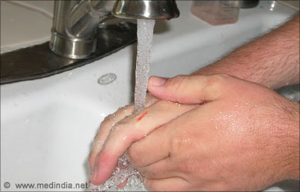

Slide 4
2. Deep cuts:-
May bleed heavily
May expose underlying tissues
Treatment For Deep Cuts
May require stitching
Requires Tetanus Toxoid (TT) if: a. Cut is dirty or has debris b. TT taken 5 years ago
Consult a doctor in case of: a. Delayed wound- healing b. Pus Discharge c. Fever

Slide 5
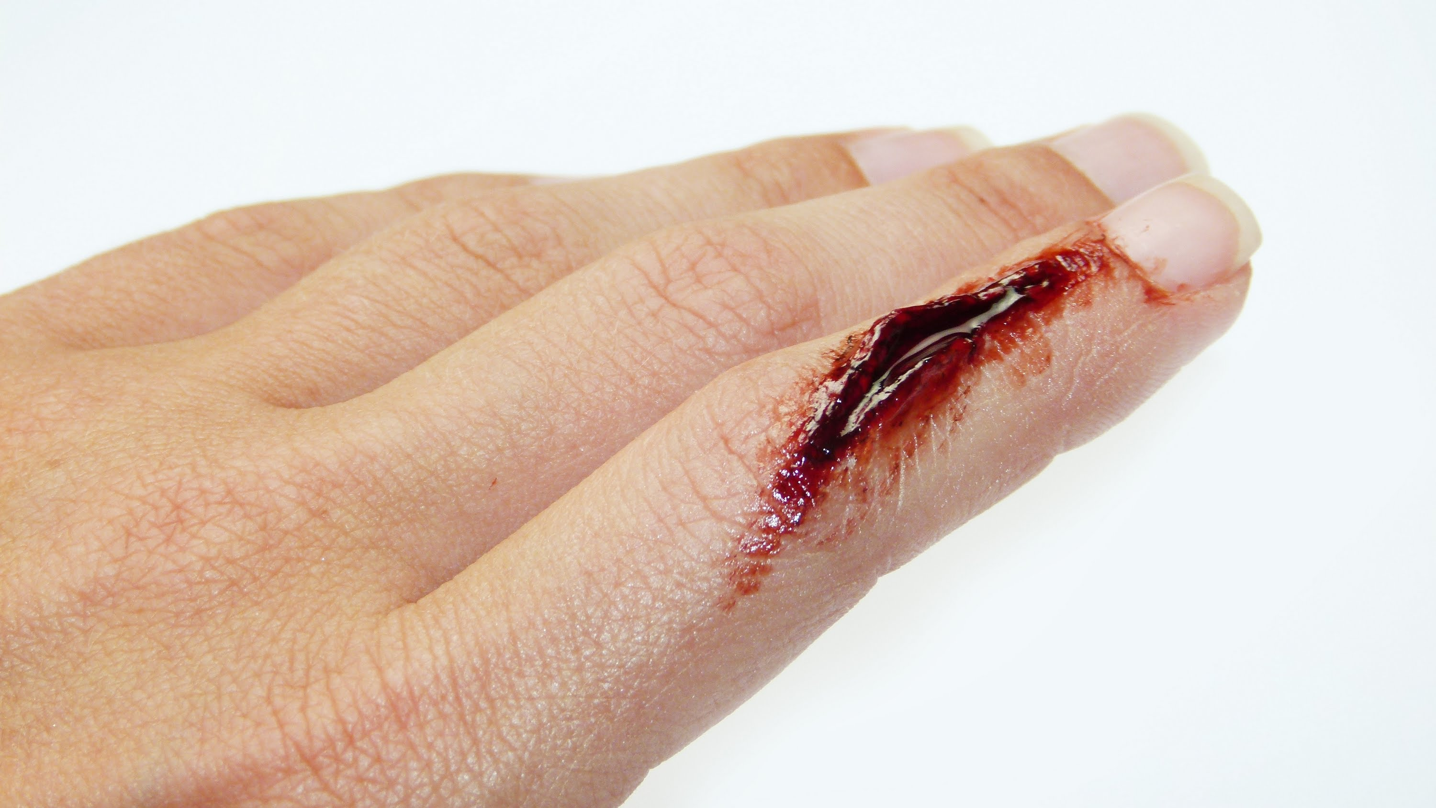

Slide 6
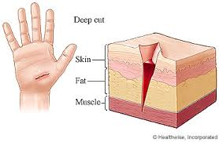

Slide 7
Points to note Do not try to clean a major wound
Do not remove deeply- lodged debris
Do not breathe on an open wound
Do not push back exposed body parts

