Slide 1
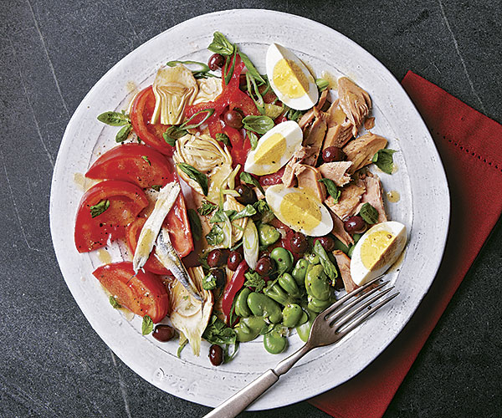
Salade Niçoise

Slide 2
For the vinaigrette
1/4 cup red wine vinegar
1 Tbs. Dijon mustard
3/4 cup extra-virgin olive oil
Kosher or sea salt and freshly
ground black pepper
For the salad
2-1/2 lb. tomatoes (8 to 10 medium), cored and sliced into wedges
Kosher salt
1 clove garlic, peeled and halved (optional)
1-1/2 cups fresh or thawed frozen fava beans, skinned if necessary
1-1/2 lb. artichokes (about 6 small), trimmed, choke removed, and sliced very thinly lengthwise
1 medium red bell pepper, trimmed, quartered lengthwise, and very thinly sliced crosswise
4 scallions, trimmed and thinly sliced
6 hard-cooked eggs, peeled and quartered lengthwise
1 cup Niçoise olives (or other black olives)
6 oil-packed anchovy fillets
10 to 12 oz. jarred or canned high-quality oil-packed tuna, drained
Freshly ground black pepper
8 to 10 fresh basil leaves

Slide 3
Make the vinaigrette
In a small bowl, whisk the vinegar and mustard. Continue whisking as you add the olive oil in a slow, steady stream to emulsify. Season to taste with salt and pepper. Set aside.
Make the salad
Place the tomato wedges in a large colander and sprinkle with 1/2 tsp. salt. Let drain for 20 minutes.
Rub a serving platter or six plates with the garlic to subtly perfume the dish, if you like; discard the clove.
Arrange the tomatoes and other vegetables, eggs, and olives on the platter or plates. Drape the anchovies over the top. Flake the tuna into bite-size pieces, and arrange on the salad. Drizzle the vinaigrette over the salad, and season to taste with salt and pepper. Rip or snip the basil leaves into pieces, scatter over the salad, and serve.

