Slide 1
Sweetener

Slide 2
a substance used to sweeten food or drink, especially one other than sugar.

Slide 3
Classification
1. Sugars 2. Sugar Alcohols 3. Natural Caloric Sweeteners 4. Natural Zero Calorie Sweeteners 5. Modified Sugars 6. Artificial Sweeteners

Slide 4
1. Sugars.
These are carbohydrates and contain 4 calories per gram. They are found naturally in many foods including fruit, vegetables, cereals and milk. They can be harmful to teeth.
The most common are:
Sucrose, Glucose, Dextrose, Fructose,
Lactose, Maltose, Galactose and Trehalose.

Slide 5
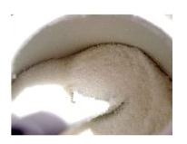

Slide 6
2. Sugar Alcohols
Like sugars these are carbohydrates and occur naturally, though in small amounts, in plants and cereals. They typically contain fewer calories per gram than sugar and do not cause tooth decay.
Most common are:- Sorbitol, Xylitol, Mannitol, Maltitol, Erythritol, Isomalt, Lactitol, Glycerol

Slide 7
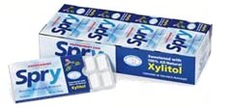

Slide 8
3. Natural Caloric Sweeteners
These are the oldest known sweeteners and include honey and maple syrup. They contain sugar but also other nutritive qualities. They can also be harmful to teeth.
They include: Honey, Maple Syrup, Coconut Palm Sugar and Sorghum Syrup.

Slide 9
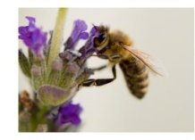

Slide 10
4. Natural Zero Calorie Sweeteners
These are not carbohydrates and contain little or no calories. It is only in recent years that interest has grown in these as a better alternative to artificial sweeteners. They are harmless to teeth. Like artificial sweeteners they can have an aftertaste.
They include: Luo Han Guo, Stevia, Thaumatin, Pentadin, Monellin, Brazzein.

Slide 12
5. Modified Sugars.
These are typically sugars produced by converting starch using enzymes. The list also includes sugars that have been modified such as caramel or golden syrup. They tend to have a high glycemic index and can be harmful to teeth. They are often used in cooking or in processed foods.
A few are: High Fructose Corn Syrup, Refiners Syrup, Caramel ,Inverted Sugar, Golden Syrup.

Slide 13
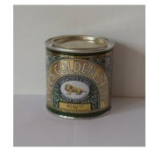

Slide 14
6. Artificial Sweeteners.
There are many types on the market and some appear to be safer than others. They have been in use in America and Europe for over 120 years and are harmless to teeth.
The most common are:
Aspartame, Sucralose, Saccharin, Neotame,Acesulfame K, Cyclamate.

